Slide 1
C to Rust : Chapter 11 Functions
ZACOCTORUST

Slide 2
Learning Journey:
Functions 101
Overview of Functions
Parameters and returning a value
Using an explicit return statement
Rust Lab #17
Functions and ownership
Rust Lab #18
Returning multiple values
HOFs
Closures
Rust Lab #19
Function documentation
Rust Lab #20
Macros
Rust Lab #21
Summary
Appendices:
Rust keyword mapping for this chapter
Learning Outcomes:
Identify opportunities to create Rust functions or macros
Create standalone functions using SRP
Apply references correctly to avoid ownership issues when using functions
Functions
Prerequisites: Basic familiarity with Microsoft Windows and the command prompt.

Slide 3

Functions are the focus of modular programming
Decomposing complex problems into smaller, more manageable "chunks"
Why do this?
Ease of writing and general readability
Unit testing becomes easier (as function-oriented)
Code is reusable in other projects
Coding productivity (multiple developers working on same codebase, simultaneously)
The core thing to remember is:
SRP (Single Responsibility Principle)
A function has one job, and does it well
Rust's function syntax will seem familiar
Particularly to C-Family and Python software developers
Functions 101

Slide 4

Functions are critical to writing good Rust programs
main() is the standard entry point of many programs
Style-wise, functions are named using the snake_case convention
Functions are defined using the following format:
Functions can be defined before or after main; Rust doesn't mind
Overview Of Functions
fn function_name(arguments) -> return_type {
action 1
action 2
:
action ^{n}
return value
}
fn say_hello() {
println!("Hello, crustaceans!");
}
fn main() {
say_hello(); //calls the function
}
STDOUT
Hello, crustaceans!
Notes:
Rust's function syntax is familiar to those who have completed any significant software development. There are some interesting quirks, e.g. return statements vs final expressions, but generally the concepts here are relatively easy to understand.
Technical notes
By default, Rust functions return an empty tuple or the unit type "()" – which is optional, otherwise use "-> ()"
Rust functions are sometimes (more formally) referred to as function blocks.
Unlike C, the function definition order doesn't really matter, including nested functions, i.e. with inner and outer scopes.
Further reading:
https://doc.rust-lang.org/reference/items/functions.html

Slide 5
Functions may have parameters
These form part of the function's signature
Formal parameters are in the function's header
Actual parameters (concrete values) are typically called arguments
Many programmers use terms parameters/arguments interchangeably
Here's an example of a simple Rust function with arguments and a return type:
Parameters And Returning A Value
use std::f32::consts::PI;
fn calc_circle_area(radius: f32) -> f32 {
let result = PI * radius * radius;
result
}
fn main() {
let rad = 4.5;
let area = calc_circle_area(rad);
println!("Area of circle with radius {:.2} is {:.2}", rad, area);
}
STDOUT
Area of circle with radius 4.50 is 63.62
Notes:
There are several things to notice in this example.
Let's start by examining the placement of the function – it's above main() – that's fine. As previously noted, Rust would have been happy if it had been listed afterwards and this would not have prevented the code from being compiled successfully. Essentially, if the function is defined somewhere in that file, main() can call it.
The next aspect to focus on is the calc_circle_area() function's header:
fn calc_circle_area(radius: f32) -> f32
This is indicating that the function accepts a 32-bit floating point value, calls it "radius" and it, after processing, return another 32-bit floating point value. Notice, it's not necessary to name the returned value (this is in common with a number of other programming languages, including those in the C family).
The braces form the function body – all code to be executed by the function must be written inside this scope.
The calculation is relatively painless, drawing on the Archimedes' PI constant stored in std::f64::consts crate, to calculate the area of a circle. The result of this calculation is stored in a new variable called "result".
The final line does not have the more familiar "return" keyword – it's not necessary here. Although Rust does indeed have the tried-and-tested "return" keyword, it usually implicitly specifies the "return" value by the final expression before the closing brace. By simply saying "result", it is the content of this variable that will be returned to the function caller.
Technical notes
An expression should not be ended with a ; (semi-colon) as this would make it a statement – and this would not successfully compile syntactically (it's not returning a value).
The next slide demonstrates the return statement equivalent (and that will need a semi-colon).
Further reading:
https://doc.rust-lang.org/std/f64/consts/constant.PI.html

Slide 6
As noted, most Rust functions idiomatically return values implicitly
Via a closing expression (no semi-colon)
It is possible to return a value more traditionally, i.e. explicitly
Using a C-like return statement
Here is same example demonstrating this alternate Rust syntax:
Using An Explicit return Statement
use std::f32::consts::PI;
fn calc_circle_area(radius: f32) -> f32 {
let result = PI * radius * radius;
return result;
}
fn main() {
let rad = 4.5;
let area = calc_circle_area(rad);
println!("Area of circle with radius {:.2} is {:.2}", rad, area);
}
STDOUT
Area of circle with radius 4.50 is 63.62
Notes:
Technical notes
It should be noted that Rust software developers tend to only use the "return" statement when exiting a function prematurely or when multiple exit points are identified.
Further reading:
https://doc.rust-lang.org/book/ch03-03-how-functions-work.html

Slide 7
C to Rust Lab #17
Writing functions
Notes:
This lab focuses on writing functions in Rust.

Slide 8
Imagine we wanted to remove all instances of a given character from a string
A custom Rust "cleaner" function seems like a sensible idea:
Unfortunately, this won't compile – the error message is on the next slide…
Functions And Ownership (1)
fn clean_string(original: String, filter: char) -> String {
let length = original.len();
let mut cleaned = String::with_capacity(length);
for each_char in original.chars() {
if each_char != filter {
cleaned.push(each_char);
}
}
cleaned
}
fn main() {
let before = String::from("data&is&messy");
let after = clean_string(before, '&');
println!("Before: {}", before);
println!("After: {}", after);
}
Notes:
Algorithmically, this makes sense but passing the "before" string into the function for processing causes us an issue when we want to print "before" and "after" following the successful function call.
Technical notes.
There are smarter ways to do it in Rust using iterators etc. – more on those later!

Slide 9
Here's the error message:
As you can see, the issue is passing "before" into the function.
Once this happens, the function has ownership of the data.
And we can't then use it afterwards in the println! macro.
C:\Users\QA\rust>rustc stringclean.rs
error[E0382]: borrow of moved value: `before`
--> stringclean.rs:17:24
|
15 | let before = String::from("data&is&messy");
| ------ move occurs because `before` has type `String`, which does not implement the `Copy` trait
16 | let after = clean_string(before, '&');
| ------ value moved here
17 | println!("Before: {}", before);
| ^^^^^^ value borrowed here after move
error: aborting due to previous error
For more information about this error, try `rustc --explain E0382`.
Functions And Ownership (2)
Notes:
Fortunately, if you recall, there is a solution.
Technical notes
As usual, Rust offers an additional explanation if you wish to view the likely cause: rustc --explain E0382

Slide 10
The solution is to let the function borrow the original string
Rather than transfer ownership of it to the function
Uses the & (reference) operator (a type of pointer)
A Rust function seems like a sensible idea:
Functions And Ownership (3)
fn clean_string(original: &String, filter: char) -> String {
let length = original.len();
let mut cleaned = String::with_capacity(length);
for each_char in original.chars() {
if each_char != filter {
cleaned.push(each_char);
}
}
cleaned
}
fn main() {
let before = String::from("data&is&messy");
let after = clean_string(&before, '&');
println!("Before: {}", before);
println!("After: {}", after);
}
STDOUT
Before data&is&messy
After dataismessy

Slide 11
C to Rust Lab #18
Functions and ownership
Notes:
This lab focuses on writing functions in Rust and navigating ownership issues.

Slide 12
As with many other languages, Rust uses a tuple to return multiple values from a function.
Note the parentheses!
Returning multiple values
fn min_max(data: [i32; 6]) -> (i32, i32) {
let min = *data.iter().min().unwrap();
let max = *data.iter().max().unwrap();
(min, max)
}
fn main() {
let my_data: [i32; 6] = [20, 10, 40, 60, 30, 50];
let (min, max) = min_max(my_data);
println!("min is {min}");
println!("max is {max}");
}
STDOUT
min is 10
max is 60
Notes:
C programmers typically return a structure containing multiple data items, but in many modern programming languages (e.g. Python) a tuple is used instead, as is the case here.
Note that the return keyword has not been used in this example to retain the idiomatic approach to Rust's function mechanism.

Slide 13
HOF = Higher Order Function
Classically:
Functions whose parameters and/or return values are functions
Indicates they are "first class citizens"
A foundational feature of functional (not modular) programming
HOFs
// normal functions
fn add(a: i32, b: i32) -> i32 {
a + b
}
fn mul(a: i32, b: i32) -> i32 {
a * b
}
// HOF
fn binary_op<F>(a: i32, b: i32, op: F) -> i32
where
F: Fn(i32, i32) -> i32
{
op(a, b)
}
// create values and loop through binary operators
fn main() {
let c = 10;
let d = 5;
let ops = [add, mul];
for op in ops {
println!("{}", binary_op(c, d, op));
}
}
STDOUT
15
50
Notes:
In this example we create a couple of standalone "binary operation" functions, e.g. one which adds two integers, another which multiplies them together.
We then create a HOF which accepts three arguments (2 integers and a function name).
As you will see, when we create an array of the function names, we iterate over them and call the "binary_op" function, passing the values and the desired function to execute.
Notationally, "F" represents our "function" type here.
Some of you may have seen similar techniques in C (using function pointers) and Python (using function references).
What code would be required to complete the "sub" and "div" quartet of traditional binary arithmetical operators?

Slide 14
In Rust, a closure is a special type of function
Anonymous – has no name nor traditional definition
Can be thought of as a lambda function
Here's a traditionally-coded Rust function to convert Celsius to Fahrenheit
Here's the closure equivalent:
Rewritten using a closure:
Closures – An Introduction
fn c_to_f(cel: f32) -> f32 {
let fah = cel * 9.0/5.0 + 32.0;
fah
}
fn main() {
let temp_c = 100.0;
let temp_f = c_to_f(temp_c);
println!("{:.2} Deg C is {:.2} Deg F", temp_c, temp_f);
}
STDOUT
100.00 Deg C is 212.00 Deg F
fn main() {
let temp_c = 100.0;
let c_to_f = |cel| cel * 9.0/5.0 + 32.0;
println!("{:.2} Deg C is {:.2} Deg F", temp_c, c_to_f(temp_c));
}
Notes:
Technical notes
Braces are optional for one-line closures, as above.
Closures are also able to access variables in their enclosing environment, something a traditional function cannot do, e.g.
fn main() {
let temp_c = 100.0;
let c_to_f = || temp_c * 9.0/5.0 + 32.0;
println!("{:.2} Deg C is {:.2} Deg F", temp_c, c_to_f());
}
Notice, the closure has accessed temp_c from it’s environment, meaning no need to pass an argument or have a parameter.

Slide 15
Closures also support:
Explicit type declarations for parameters and return type
Multiples lines of code
Here's the same closure written in a more explicit manner:
Things to notice:
Type declaration for argument is inside the | |
Braces are used for multiple lines of code
Implicit return (as expression) must not have a semi-colon
Let statement must be terminated with a semi-colon
Closures – More Explicitly Coded!
fn main() {
let temp_c = 100.0;
let c_to_f = |temp_c: f32| -> f32 {
let fah = temp_c * 9.0/5.0 + 32.0;
fah
};
println!("{:.2} Deg C is {:.2} Deg F", temp_c, c_to_f(temp_c));
}

Slide 16
C to Rust Lab #19
Closures
Notes:
This lab focuses on writing closures in Rust

Slide 17
Rust doc ("rustdoc") documentation can be created using:
rustdoc tool
via "cargo doc"
Use the /// comment style
Mark the function as public
By default, documentation is only generated for public functions
It is possible to add function documentation quite easily, e.g.
Function Documentation (Rustdoc Introduction)
/// Cleans string of undesirable character
///
/// Removes and returns a filtered string.
/// Usage: clean_string(&your_string, '&')
pub fn clean_string(original: &String, filter: char) -> String {
let length = original.len();
let mut cleaned = String::with_capacity(length);
for each_char in original.chars() {
if each_char != filter {
cleaned.push(each_char);
}
}
cleaned
}
Notes:
Documentation is created in target/doc folder
Technical notes
You may have noticed the addition of the pub keyword to the function name? This makes modules, function or data structures visible from within external modules. It's necessary here to allow the rustdoc tool to include it for documentation generation, otherwise it will be excluded and the crate's doc will be empty.
Further reading:
https://doc.rust-lang.org/rustdoc/what-is-rustdoc.html

Slide 18
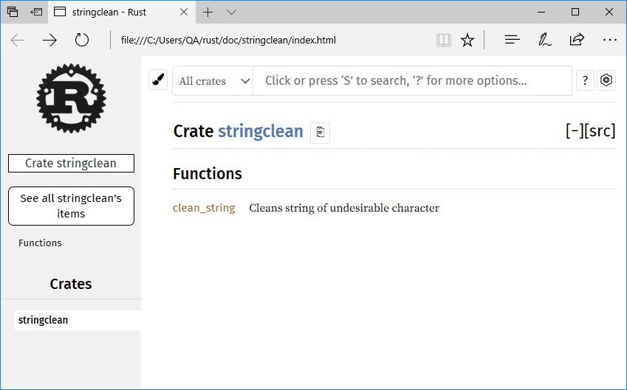
Rustdoc is created in a "doc" folder hierarchy
Includes all the necessary HTML, CSS, JavaScript etc to navigate the documentation
Simply access the index.html page in the correct folder:
Viewing
Function Documentation

Slide 19
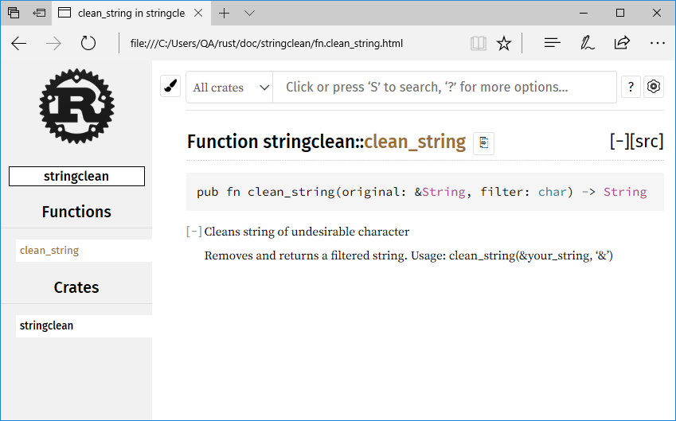
And then click on the appropriate function:
Helpfully, any Rust language data types hyperlink back to the official Rust documentation.
Viewing
Function Documentation
Notes:
Technical notes
The crate name is assumed from the given source code's filename.
To override this, simply add the correct argument and value:
rustdoc myfile.rs --crate-name my_crate

Slide 20
C to Rust Lab #20
Rustdoc for functions
Notes:
This lab focuses on creating function documentation in Rust

Slide 21
Macros are an example of the metaprogramming discipline
Program code modifying program code at compile-time rather than generating a run-time function call
Rust macros look like functions, but end with a ! ("bang"/"exclamation")
Think print!(), println!() etc.
Rust macros are more powerful than their C counterparts
Expand into full source code, not just string pre-processing
…so no unexpected precedence issues
Why use a macro?
An easy way to provide similar functionality for different types of data
DRY – don't repeat yourself
Allows us to define a variadic interface
Something which accepts a flexible number of arguments/parameters
Again, think print!(), println!() etc.
Macros
Notes:
Further reading:
https://doc.rust-lang.org/stable/rust-by-example/macros.html

Slide 22
Macros can be used in two ways:
Declaratively – to generate a complex expression using simpler "sugar"
Procedurally – to generate new rust code from existing rust (essentially "metaprogramming“ which manipulates the AST)
Custom declarative macros are themselves created using a macro!
macro_rules!
Let's examine a declarative example first:
It is possible to generate the expanded code via rustc or Cargo tool options*
Creating a Declarative Macro
macro_rules! mult_as {
($num1:expr, $num2:expr, $tipe:ty) => {
$num1 as $tipe * $num2 as $tipe
}
}
fn main() {
println!("{}", mult_as!(10, 12.5, u16));
println!("{}", mult_as!(10, 12.5, f32));
}
STDOUT
120
125
Notes:
Of course, if you don’t want to support arguments, simply don’t specify any:
macro_rules! something {
// The unit or `()` indicates that the macro takes no argument
() => {
//do something here!
};
}
When compiled, a declarative macro invocation is parsed and replaced by the Rust code equivalent expression. This expression is tokenised as part of the normal Rust AST (abstract syntax tree) during the analysis phase. This makes it a much more complex (and powerful) operation than the simple macro text substitution applied by other languages, e.g. the pre-processor in C, where it’s find and replace nature can create potential precedence problems.
Technical notes
* Although this functionality is often only available in the nightly builds of the Rust compiler (as the option is treated as unstable) and even then, has frequently changed syntax command line syntax.
Further reading:
https://doc.rust-lang.org/reference/macros.html
https://createlang.rs/01_calculator/ast.html

Slide 23
It’s possible to create a Macro which matches against multiple expressions passed in the argument:
Uses asterisks to indicate multiple arguments are to be processed
Note the trailing one!
macro_rules! heading {
// match rule for supporting multiple expressions
($($x:expr),*) => {
$(
println!("{:*^40}", $x);
)*
};
}
fn main() {
// Calls our macro with (potentially) multiple arguments
heading!("Ron");
heading!("Frank", 2, 3.8);
}
Macros with Multiple Expressions
STDOUT
******************Ron*******************
*****************Frank******************
*******************2********************
******************3.8*******************
Notes:
Essentially, at compile time, these multiple expressions are parsed and the source code is processed “in-place” to replace the macro with three separate println!() functions – one for each argument passed into the heading! macro.

Slide 24
Macros can even be used recursively…
// Macro declaration with a difference…
macro_rules! sum {
// match rule when there's one argument
($a:expr) => {
$a
};
// match rule when there are multiple arguments present
($a:expr, $($rest:expr),*) => {
$a + sum!($($rest),*) // A recursive call to sum the rest
};
}
fn main() {
let result = sum!(1, 2, 3, 4, 5);
println!("The sum is: {result}");
let result2 = sum!(10, 20, 30);
println!("The sum is: {result2}");
}
Macros can be Called Recursively
STDOUT
The sum is: 15
The sum is: 60
Notes:
This macro has two match rules: one for single arguments, one for multiple arguments – and they are matched accordingly when called.
This line:
sum!($($rest),*)
Is actually a recursive pattern, forever expanding the input and applying the + operator until the final total is reached and returned (via expression).
For e.g. let result = sum!(1, 2, 3, 4, 5);
sum!(1, 2, 3, 4, 5) → 1 + sum!(2, 3, 4, 5)
sum!(2, 3, 4, 5) → 2 + sum!(3, 4, 5)
sum!(3, 4, 5) → 3 + sum!(4, 5)
sum!(4, 5) → 4 + sum!(5)
sum!(5) → 5
Then unwinding after reaching last argument, in reverse order so:
4 + 5 = 9
3 + 9 = 12
2 + 12 = 14
1 + 14 = 15

Slide 25
C to Rust Lab #21
Macros
Notes:
This lab focuses on creating declarative macros in Rust

Slide 26
Rust functions are similarly structured to those in other languages, e.g. C-family, Python etc.
The main() function is the entry point for Rust programs
Rust programmer-defined functions may occur before or after main()
Rust functions may use expressions or explicit return statement mechanisms
Passing variables into a function will move ownership of the data to that function
Unless borrowed
Borrows must be tagged as mutable if you want function to alter these values
Functions can return multiple values or compound types
Functions are first-class citizens
Closures are quite popular in Rust and have terse syntax
Can access variables in enclosed scope
Macros are a useful alternative to consider and can be very flexible.
Summary

Slide 27
Any questions?

Slide 28
Appendices
Notes:
Some additional information you may find useful…

Slide 29
Rust keywords (Strict)
as | async* | await* | break | const | continue
crate | dyn* | else | enum | extern | false
fn | for | if | impl | in | mod
let | loop | match | move | mut | pub
ref | return | self | static | struct | super
trait | true | type | unsafe | use | where
while
Rust keyword mapping for this chapter
* as of Rust's 2018 Lexer
Rust keywords (Reserved)
abstract | become | box | do | final | macro
override | priv | try* | typeof | unsized | virtual
yield | while
* as of Rust's 2018 Lexer
Rust keywords (Weak)
dyn* | 'static | union
* as of Rust's 2015 Lexer
Notes:
In Rust, keywords are separated into three distinct categories.
These categories are:
Strict
Reserved
Weak
Each category refers to the keywords level of restriction in terms of naming identifiers, e.g. items, variables, labels, crates etc.
In detail then:
Strict - cannot be used for naming identifiers
Reserved - at time of writing, these keywords are reserved for future use (to make existing code forward-compatible with new Rust language development)
Weak - only have special meaning in particular contexts, so may be usable as an identifier ("union" is the quoted example of this)
In addition it is possible to use raw identifiers. A raw identifier allows you to use keywords as an identifier; simply prefix the keyword with "r#".
For example…
fn move() {
//do something…
}
won't compile.
However, this will:
fn r#move() {
//do something…
}
In addition, the "r#" must also be used on the function call itself.

